Slide 1



<NAME OF THE PROJECT>
A quiz for nerds
IBRAHIM HASSAN
Chaime Leaboub
Python, Front end, Unity
2023 – 2024
Notes:
1. INTRODUCTION

Slide 2
<NAME OF THE PROJECT>
My project is a quiz made for nerds, basically it acheives to collect data based on the users answers which could help with personalizing ads and help out small cooperations in the entertainment industry
IBRAHIM HASSAN

Slide 3
<NAME OF THE PROJECT>
<BULLET POINTS METHODOLOGY>
( Schema or key points )
IBRAHIM HASSAN

Slide 4
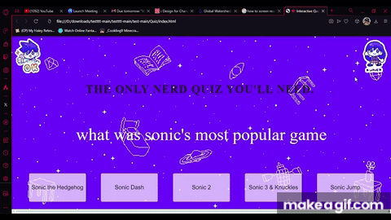
<NAME OF THE PROJECT>
<GIF moving image of Project ( if available ) >
<1-sentence value proposition>
IBRAHIM HASSAN

Slide 5
<NAME OF THE PROJECT>
If you’re interested please contact me here
for more information:
06 XX XX XX XX
IBRAHIM HASSAN

